Slide 1

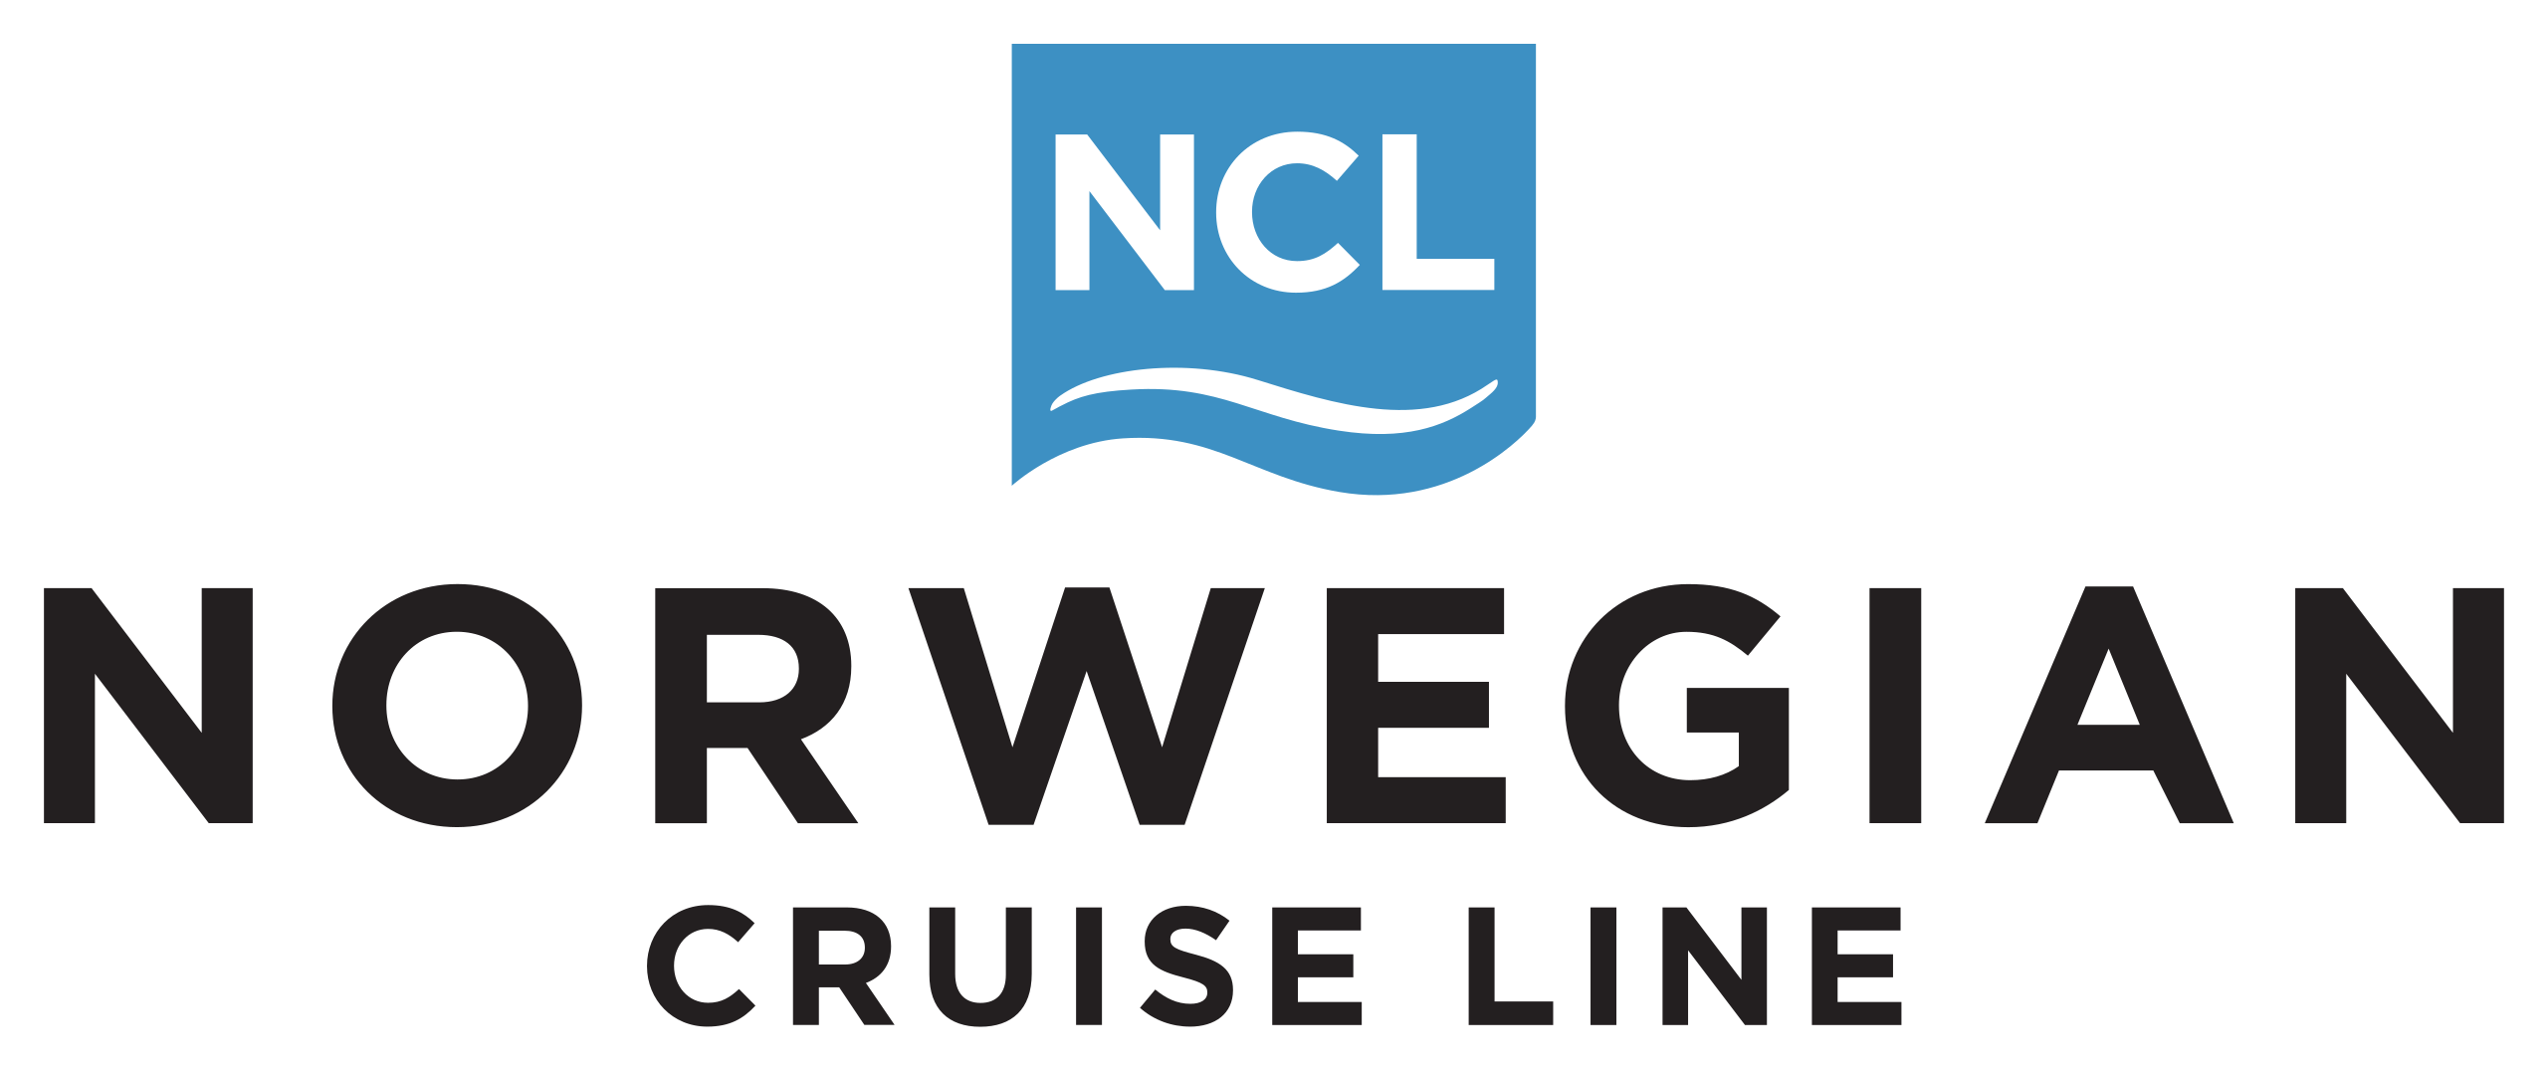

Snowflake
ML Proposal
July 2025

Slide 2
Our Understanding
The Opportunity
NCL has a portfolio of ~20 regression-type models primarily serving the marketing and sales domain. Modes are built and deployed mainly using R. A subset of models are deployed in Salesforce Einstein and others are running manually on VMs.
These models are not yet built for scalable production (e.g., CI/CD), and NCL is seeking to modernize and standardize their ML infrastructure within Snowflake. Model outputs (scoring tables) are batch-processed and stored in Snowflake, with downstream activation through internal tools like Tableau and Salesforce, and exploratory usage of Streamlit.
There’s also a desire to:
Ensure existing ML infrastructure is well prepared for future data science modernization.
Consolidate features into a shared, governed feature store within Snowflake.
Transition model development into a Git-based MLOps environment.
Define post-deployment success metrics (revenue impact, efficiency, test/control design).
Establish robust model testing, governance, and monitoring frameworks.
Migrate high-leverage models into a scalable, governed ML pipeline within Snowflake ML.
Co-develop a foundational MLOps framework that supports collaboration, versioning, retraining, and monitoring across a growing data science team.
Build a unified feature store that streamlines experimentation and increases efficiency across model development.
Accelerate time-to-value by setting repeatable playbooks for model deployment, governance, and performance evaluation.
Position Blend as an ongoing strategic partner supporting NCL’s enterprise AI/ML maturity roadmap from migration to full ML lifecycle management.
Private and Confidential
2

Slide 3




Our Approach: Retainer-Based Pod
We propose a dual-skilled retainer team of Data Engineering and Data Science practioners that co-develops, implements, and transitions to a modern ML production environment.
What We Will Do
Key Deliverables
Infrastructure / Readiness Audit: Initial discovery and review of technical systems and connections to identify any gaps or risks to model build/deploy.
Model Migrations: Convert high-value R models into production-grade pipelines using Snowflake ML and orchestrated CI/CD workflows.
MLOps Infrastructure: Implement Git-driven workflows, automated retraining pipelines, and structured model release processes.
Feature Store: Design and implement a scalable Snowflake-native feature store with data science-led feature selection and engineering, and highly efficient production architecture.
Model Monitoring: Implement monitoring functionality in SnowflakeML and create dashboards (Tableau/Streamlit) for model health, data drift, and performance over time.
Governance and Playbooks: Document best practices for model deployment, testing (including test vs. control), retraining schedules, and post-launch measurement of business impact.
Operational model governance and playbooks
Enterprise-Grade Feature Store Established
Production-Ready ML Pipeline in Snowflake
End-to-end MLOps Process and Framework
Outcomes
Modern ML Production Framework in Snowflake
Scalable Feature Store to serve Enterprise Data Science
End-to-End MLOps and Governance Frameworks

Slide 4
Illustrative Timeline
Blend will co-create process foundations with your team to ensure adoption and high impact
MLOPS FOUNDATION DELVELOPMENT
Month 1 | Month 2 | Month 3 | Month 4 | Month 5 | Month 6
Discovery and Planning
Team mobilization and access
Confirm model inventory, priorities, and stakeholders
Audit current state (models, pipelines, data sources)
Infrastructure readiness assessment (Snowflake, downstream tools)
Align on governance, MLOps goals, and collaboration model
Define success metrics and initial backlog
Foundational Set-Up
Stand up Git-based MLOps framework and CI/CD pipelines
Design and begin building Snowflake-native feature store
Start migrating 1–2 high-priority models (R to Python/Snowflake ML)
Begin defining monitoring/observability framework
Model Migration and MLOps Hardening
Complete migration of initial batch of models
Operationalize retraining workflows and model scoring pipelines
Implement model versioning and performance monitoring
Embed Streamlit dashboards for model and feature monitoring (pilot)
Governance & Expansion
Finalize and document playbooks for model deployment, testing, and impact measurement
Begin onboarding additional models using refined approach
Expand feature store and begin driving reuse across DS team
Enablement and KT
Co-develop training materials for internal team
Transfer ownership of CI/CD and monitoring frameworks
Final review of deployed models, dashboards, and infrastructure
Roadmap and staffing plan for Phase 2 (continued scale + innovation)

Slide 5
Team & Responsibilities
Delivery Leader
Owns overall project delivery, ensures alignment with NCL’s goals, and guides both strategic and technical direction. Acts as primary point of contact and ensures cross-functional coordination.
Data Engineering Leader
Leads architecture and implementation of the Snowflake-based ML infrastructure, including the feature store, model pipelines, and MLOps integration.
Drives best practices and ensures scalability.
Data Engineer
Executes the technical build of the feature store, CI/CD pipelines, and model scoring infrastructure within Snowflake.
Works closely with DS team to translate model requirements into production-ready code.
Data Scientists (x2)
Collaborate on refactoring and migrating R-based models into the new ML environment.
Define and document features, evaluate model performance, support monitoring frameworks, and contribute to post-deployment testing design.
Define playbooks for model explainability, performance evaluation, health and lifecycle performance evaluation.
MLOps Practice Leader (Blend investment)
Designs core MLOps framework (CI/CD, monitoring, Git workflows), co-develops scalable processes with NCL’s team, and provides strategic guidance to ensure long-term sustainability.
Delivery Leader
Data Engineering Leader
MLOps Practice Leader
Blend Investment
Data Scientist
Data Engineer
Data Scientist

Slide 6
Commercial Options
Option 2 would need further discovery or
Woking sessions to align on specific scope
and deliverables.
Option 1: Fixed Monthly Retainer (Blended POD)
Structure: A fixed monthly fee over 6 months for a dedicated cross-functional team
Estimated Cost Range: $80k / month
Ideal For: Collaborative, dynamic engagements where priorities may shift and team capacity is more valuable than strict deliverables.
Investments from Blend:
MLOps Practice Leader - Dedicated time from a senior MLOps architect to define framework and guide internal adoption (included, not billed separately)
Re-Usable IP/Accelerators - Access to Blend’s internal feature store templates, model deployment frameworks, and dashboarding standards.
Flexible Access to Specialists: On-Demand SME pull in from Blend global resource platform w/out additional fees
Option 2: Fixed Monthly Retainer (Blended POD)
Structure: Defined payment milestones based on delivery of key assets (e.g., feature store MVP, 5 model migrations, CI/CD pipeline setup, dashboard delivery, etc.)
Estimated Cost Range: $490 – 500k total estimating 6-month delivery plan
Example Milestones:
Project kickoff, backlog, and foundational design ($75K)
Feature store MVP and first 2 model migrations ($125K)
CI/CD pipelines + monitoring framework live ($125K)
Final batch of models migrated + Streamlit dashboards ($125K)
Enablement, playbooks, knowledge transfer, roadmap ($75K)
Ideal For: clients and/or procurement and finance teams that prefer payment aligned to tangible deliverables and risk-managed execution
Investments from Blend: (same as option 1)

Slide 7
Our Success Stories

Slide 8



Scaled MLOps Implementation & Transformation
Media / Entertainment
Overview
A major media and entertainment company sought to modernize and scale its marketing data science operations. The client’s internal teams were challenged with fragmented machine learning (ML) development, slow deployment timelines, limited monitoring, and inconsistent model performance across global initiatives.
Challenges
Solutions
Accelerating MLOps maturity and reducing operating costs for a Global Leader in Media & Entertainment
The client’s marketing data science team was responsible for developing models that support cross-channel attribution and audience propensity scoring. However, they faced:
Operational Bottlenecks: Long model deployment cycles and manual model operations.
Low Visibility: No centralized system for model monitoring, reproducibility, or collaboration.
Inefficiencies at Scale: Inability to support the growing demand for models and ensure reliability under production-grade workloads.
Cloud Cost Waste: Ineffective resource management across Databricks, Snowflake, and AWS environments.
Blend designed and executed a 10-week MLOps pilot program to implement a baseline MLOps framework
using MLFlow, GitHub, and Confluence, focusing on two high-priority use cases:
This Engagement Included
A structured Discover → Design → Implement methodology.
A scalable CI/CD pipeline automating model deployment, testing, and monitoring.
Documentation of architectural blueprints, performance metrics, and a playbook for future
MLOps operations.
Close collaboration across Audience Science and Measurement Science teams with defined KPIs, stakeholder governance, and ongoing feedback loops.
Business Impacts
80%
Cloud cost savings (based on past implementations)
95%
Reduction in time to
market for models
85%
Improved model uptime
and reliability

Slide 9

Real-Time Bidding ML System Migration from AWS to GCP
Media / Telecom
Challenges
Impacts
Seamlessly migrate from AWS to GCP without disrupting 24/7 operations.
Modernize the ML infrastructure to be cloud-agnostic and container-native.
Replace AWS-native services with open-source, portable components.
Validate and ensure consistency of ML model performance post-migration.
GCP-based pipelines achieved consistent or improved machine learning performance compared to the AWS system while delivering faster execution times and greater operational flexibility
Successfully transitioned to GCP-native architecture without any degradation in model accuracy or reliability
Models demonstrated identical performance metrics post-migration with comprehensive AUC, AUPRC, and feature importance validation
Established reproducible local environment for event inference testing and debugging
Deployed full staging environment replicating production events with integrated database dependencies and real-time dashboards monitoring critical metrics including win rate, average latency, P95, and P99 performance indicators
Executed canary release strategy migrating models to GCP on a single host with continuous monitoring of all staging environment metrics to ensure seamless transition
Data science rigor ensured model fidelity and safeguarded revenue-critical decisions
The new architecture enables cloud independence, better cost control, and faster innovation cycles
A major advertising technology firm operating a real-time bidding (RTB) platform migrated its machine learning (ML) infrastructure from AWS to Google Cloud Platform (GCP). The RTB system powers multi-million-dollar ad campaigns by scoring impressions in real time, making model performance and system reliability mission-critical.
Solutions
Blend implemented a comprehensive cloud modernization strategy that redesigned the infrastructure using GCP-native and open-source technologies rather than a simple lift-and-shift approach:
Spark on Kubernetes: Migrated Spark workloads from EMR to Google Kubernetes Engine with custom Docker containers for enhanced portability
Airflow on Kubernetes: Deployed Apache Airflow on Kubernetes to orchestrate Spark jobs, data validation, and model deployments with improved observability
Cloud-Native Storage: Transitioned from Amazon S3 to Google Cloud Storage, optimized for Spark and Airflow workloads
Infrastructure as Code: Provisioned entire infrastructure using Terraform for consistent environments across dev, staging, and production
Advanced Monitoring: Implemented GCP Stackdriver and Prometheus/Grafana for comprehensive observability
Data Science Validation Framework: Given the mission-critical nature of RTB scoring, established rigorous validation including historical backtesting against archived bidding logs, shadow mode deployment for real-time score comparison, and comprehensive validation metrics covering score correlation, lift-over-baseline analysis, revenue simulation, and latency benchmarks.
  Successfully retraining thousands of models daily
  100% Uptime During Migration

Slide 10

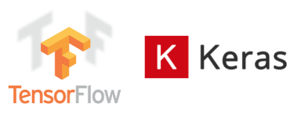

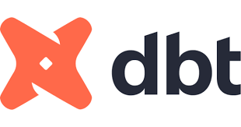
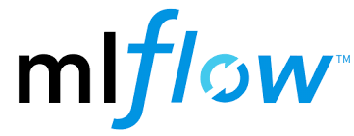
High-Performance MLOps and Model Management Platform
Retail Energy
Challenges
Impacts & Risks
Business relies heavily on daily short-term and long-term forecasts for financial management and operations
Input data change minute to minute, and arrive from myriad sources, requiring significant ETL and processing
Monolithic code structure made changes difficult and limited functionality for what-if simulation
Model development was fragmented, using disparate data stores and tools; deployment was cumbersome
Frequent data ingestion / update failures led to outdated or inaccurate projections: greater than 15% failure rate in one quarter
Variance in demand forecast directly effects cost and profit: approximately $3M for each 1% of mean error
Planners used work-around estimates because forecasts were fixed to stale business logic leading to suboptimal decisions
Updates to models were limited to monthly releases and required production downtime to complete
Implemented best-in-class MLOps capability for a retail energy provider (subsidiary of global integrated firm) enabling real-time, high-accuracy forecasting to inform all commodity trading and business management activities
Solutions
Results & Outcomes
Blend developed and built a modern MLOps environment and operating model for the business to train, evaluate and deploy new ML models for multiple business applications:
Modular code base separated key phases of forecasting system allowing for controlled change deployment and faster runtime
Data science pipelines for model development, parallel testing, governance and production deployment
New models for demand and survival forecasting using long short-term memory (LSTM) and other techniques
Model performance test and tracking dashboards in Streamlit
98% reliability in first quarter; 99.2% in first year
Improved model accuracy: 30% reduction in MAPE
Ability to plug and play model versions to create various business simulations
Deployment time for business logic changes reduced to 1-2 days from 1-2 weeks previously
Real-time automated error alerting for missing/incomplete data with orchestrated fallback mechanisms
TECHNOLOGIES DEPLOYED

Slide 11



ML-Driven Price Optimization
Pharmacy / Healthcare
Executive
Summary
Client
Background
Implementation
Process
Blend, a leading data science and AI solutions provider, partnered with Client to develop an innovative linear programming (LP) algorithm that optimizes drug prices at an individual level. This transformative solution has driven substantial cost savings for the client, reducing their liabilities and losses by over $500 million from 2021 to 2023, with projected savings of $425 million in 2024.
The Client, a prominent healthcare company, sets drug prices for pharmacies nationwide. They are contractually obligated to provide specific discounts to their clients, facing financial penalties if they fail to meet these targets or if they offer excessive discounts.
Blend worked closely with the Client stakeholders to understand their business needs and define solution requirements. The collaborative approach allowed the Client to communicate new strategies to Blend, who then handled the technical implementation. Blend managed client relationships, only escalating major blockers to the Client. In late 2023, Blend trained a client’s team to transition the solution, moving into an oversight role before fully rolling off in February 2024.
Client’s Pharmacy Benefits Management (PBM) has price guarantee contracts with insurers and pharmacies at the beginning of the year. Based on drug utilization, these guarantees may create liabilities at the end of the year. PBM wants optimal prices to minimize end-of-year liabilities
Solution
Provided
Challenges
& Objectives:
Blend developed a cutting-edge LP algorithm that optimizes prices for each individual drug, replacing client’s legacy system. The solution was initially implemented as a proof of concept in early 2021 and then scaled up to serve more clients over the following years. Blend continuously enhanced the solution, adding features to automate processes, handle diverse client needs, and provide reporting visibility to leadership.
The Client sought to optimize their pricing strategy to minimize liabilities and losses. Their legacy algorithm used a fixed percentage across all drugs, limiting their ability to fine-tune prices. The Client needed a more sophisticated solution that could optimize prices at a granular level while meeting their clients' discount requirements.

Slide 12

ML-Driven Price Optimization
Pharmacy / Healthcare
Results Achieved
Technical Highlights
The LP solution yielded significant financial benefits for Client:
LP algorithm optimizes prices at the individual drug level
Savings (M)
Solution hosted on Google Cloud Platform, with Blend assisting in setup and resolving scalability issues
Client’s Pharmacy Benefits Management (PBM) has price guarantee contracts with insurers and pharmacies at the beginning of the year. Based on drug utilization, these guarantees may create liabilities at the end of the year. PBM wants optimal prices to minimize end-of-year liabilities
Multiple versions created to handle different client needs
Automated processes developed for scalability
Reporting and visualization features added for
leadership visibility
2021
2022
2023
2024
The overall savings of the project from
year 2021 to 2024 amount to $980 million.
Data quality issues debugged in coordination with the
Client data engineering team
These savings represent a reduction in the Client’s liabilities and losses, directly impacting their bottom line.
Drug Price Optimization
Claims data
from GCP
Model
testing and integration
Debug
failed runs
Code issues –Fix inside code and parameters
Rerun
Linear Programming Optimization Model
Multiple Kubeflow components to run algorithm in parallel
Parameters and Constraints
Monitoring model outputs
Calculating liabilities projections for end of year
Price Submission
Data Processing and Model
building on GCP
Model testing using Kubeflow CICD
Productionizing model for monthly
runs on Kubeflow
Monitoring Model performance

Slide 14
Executive Summary
JetBlue has clear ambition to drive better customer experience through personalization. A strong data foundation and in-house talent set the stage, but a defined vision and plan of attack is needed to unite fragmented efforts and produce meaningful impact.
Current Challenges:
  Siloed Efforts – Teams are moving with good intent but in isolation
  Missing Orchestration – Organization is seeking a unified vision and execution plan to bring ideas to life
How Blend Can Help:
  Lead a 12-Week Cross-Functional Alignment consisting of vision definition, capability mapping, and activation planning
  Unify Teams by developing a shared North Star, clear ownership models, and coordinated execution
  Deliver Shovel-Ready Plans consisting of prioritized use cases, team workplans, and ROI narratives for leadership
JetBlue
+ Blend
=
Personalization
at Scale

Slide 15
Highlighted Case Study:
Accelerating MLOps Maturity for a Global Media & Entertainment Leader
Overview:
A major media and entertainment company sought to modernize and scale its marketing data science operations. The client’s internal teams were challenged with fragmented machine learning (ML) development, slow deployment timelines, limited monitoring, and inconsistent model performance across global initiatives.
Challenge:
The client’s marketing data science team was responsible for developing models that support cross-channel attribution and audience propensity scoring. However, they faced:
Operational Bottlenecks: Long model deployment cycles and manual model operations.
Low Visibility: No centralized system for model monitoring, reproducibility, or collaboration.
Inefficiencies at Scale: Inability to support the growing demand for models and ensure reliability under production-grade workloads.
Cloud Cost Waste: Ineffective resource management across Databricks, Snowflake, and AWS environments.
Solution:
Blend designed and executed a 10-week MLOps pilot program to implement a baseline MLOps framework using MLFlow, GitHub, and Confluence, focusing on two high-priority use cases:
Cross-Channel Attribution Model
Theme Park Enthusiast Propensity Model
This Engagement Included
A structured Discover → Design → Implement methodology.
A scalable CI/CD pipeline automating model deployment, testing, and monitoring.
Documentation of architectural blueprints, performance metrics, and a playbook for future MLOps operations.
Close collaboration across Audience Science and Measurement Science teams with defined KPIs, stakeholder governance, and ongoing feedback loops.
Business Impacts
80%
Cloud cost savings (based on past implementations)
95%
Time to market for models
85%
Improved model uptime and reliability

Slide 16


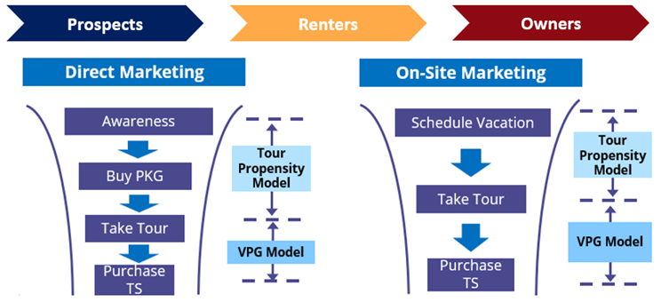

Hospitality – Sales Forecasting & Offer Optimization
Challenges
Impacts
A $2B hospitality company had been driving business through telemarketing and sales reps for the past 20 years and found that it had difficulty projecting sales, customer acquisition, or offer conversion.
Basic trial-and-error approach and difficulty understanding what levers were driving impact and which were not
Business transformation to drive impact through new digital channels for both acquisition and loyalty became an imperative for their business
The developed predictive models and forecasts that have been widely used in client’s legacy sales channels (incl. outbound and inbound telemarketing and on-site marketing) and digital channels
Models have had a significant impact on market impact, driving over 60% incremental lift over business-as-usual marketing activities
Helped a hospitality company grow package sales by 60% by forecasting and maximizing the lift of offer campaigns while reaching new audiences via new channels
Solutions
For over two years, Blend models have powered weekly package forecasts and campaign efficacy projections, optimizing sales conversion
Blend leveraged the client’s rich transactional data to develop series of time-variant propensity models and value models for different audiences and for their respective sales funnels
Blend was then able to aggregate that into package and revenue forecasts on a weekly basis that enabled the business to tweak its marketing approach throughout the quarter to meet targets
Blend also developed pilot omni-channel campaigns that included new targeting strategies and the use of display and paid social online channels that demonstrated the value of data driven marketing in new channels
HGV
16
Notes:
Customer Account Name

Slide 17

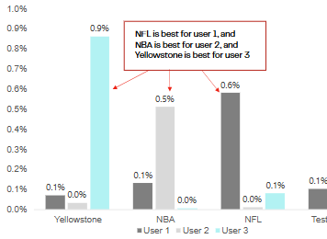
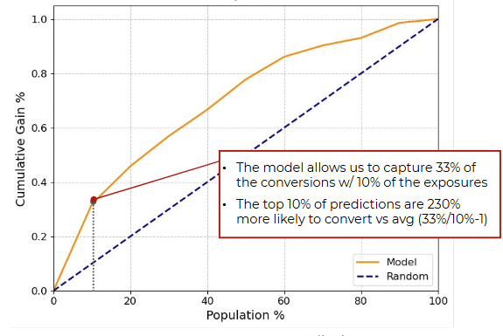
Predictive Personalization for Audience Modeling
Challenges
Impacts
Low campaign conversion rates through existing MoEngage platform
Limited user data available - only viewing habits accessible
Need for predictive capabilities to match campaigns with users’ needs and preferences based on viewing history
Improved campaign effectiveness through data-driven personalization.
  Enhanced viewer engagement
  Increased response rates through targeted messaging
A leading global entertainment streaming platform partnered with Blend to transform their viewer data into actionable insights to predict and deliver campaigns that would resonate with users based solely on viewing behavior, without access to traditional demographic data.
  ~$9.3M annual value of personalized targeting
Solutions
Developed an AI-powered model that:
  Analyzes viewing profiles to predict campaign effectiveness
  Matches users with optimal messaging
  Delivers personalized content at the right time
Implemented strategic testing program to:
  Continuously optimize campaign performance
  Minimize viewer disruption
  Validate prediction accuracy
3 User Comparison
Conversion Probabilities
Model Selected Response Rate – vs – Random
Dish

